Slide 1
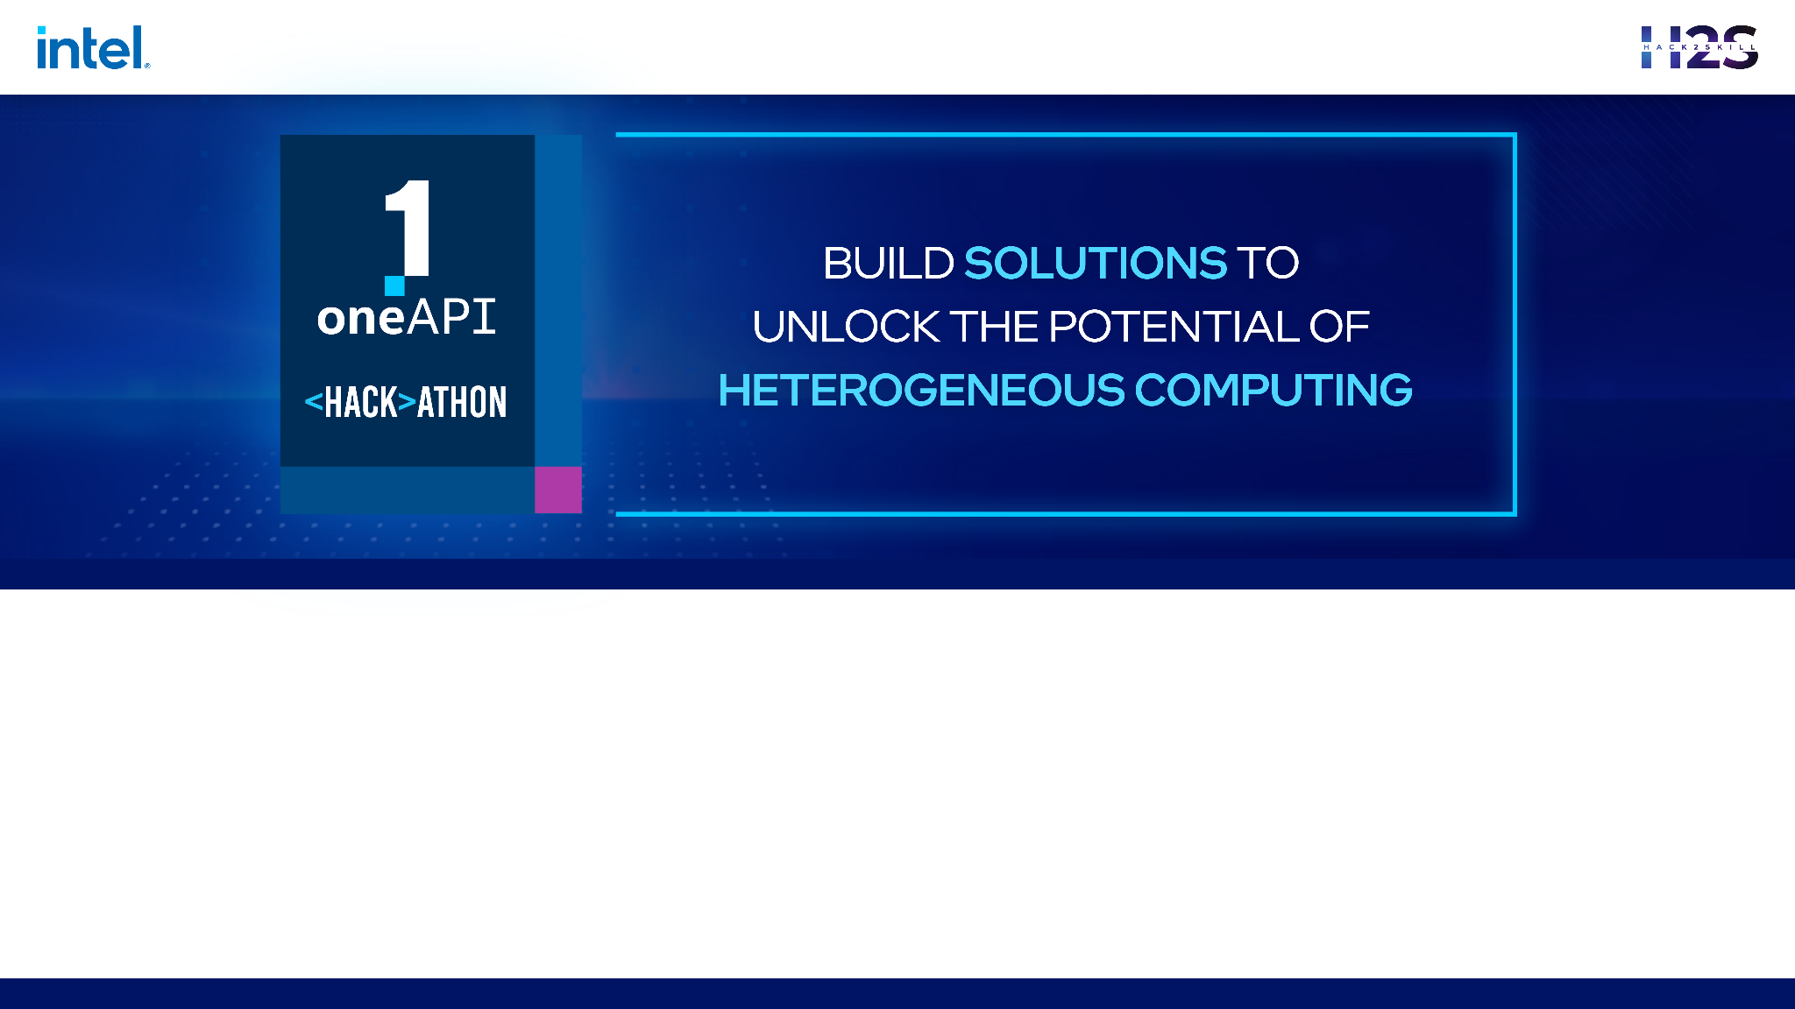
Team Name : Alpha Coders
Problem Statement : Medical Image Processing

Slide 2
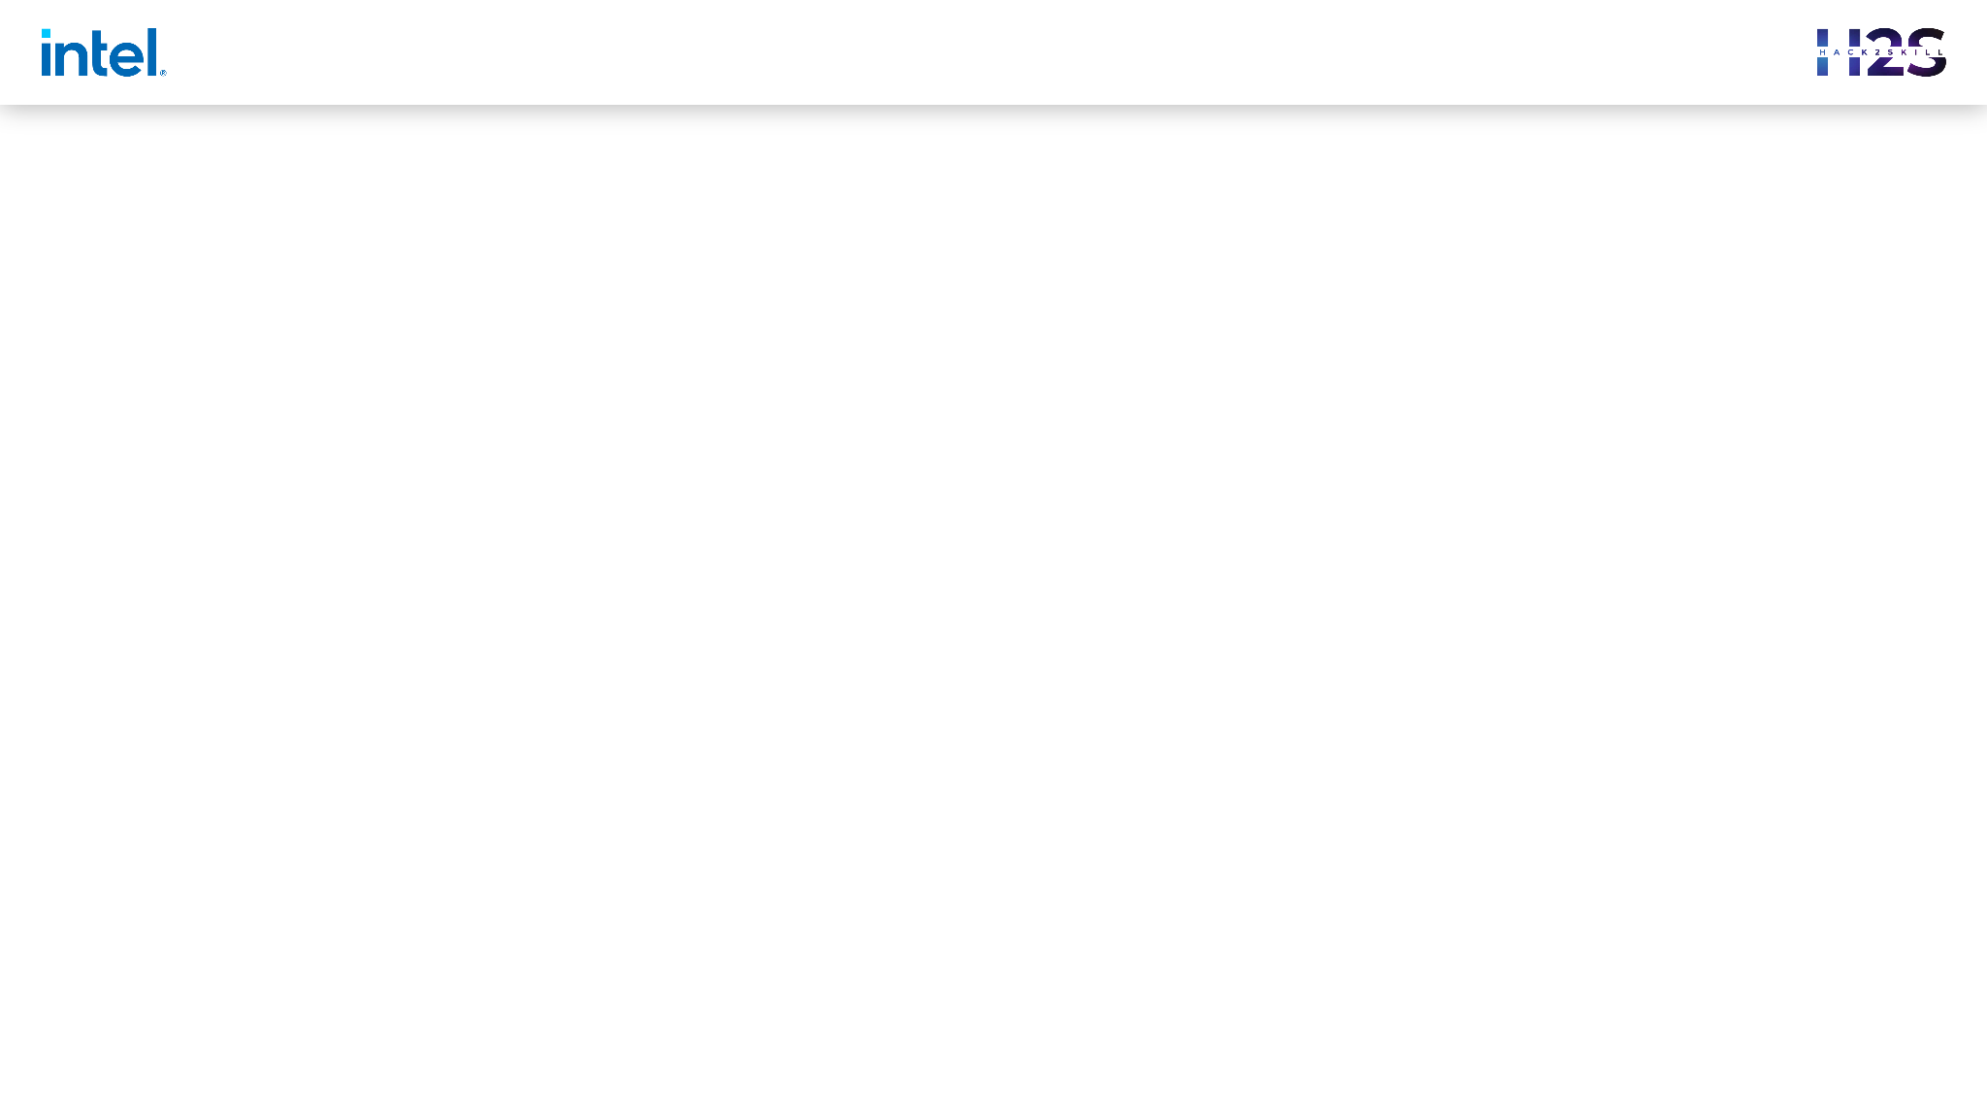

Brief about the Idea
Our project is designed to improve the speed and accuracy of processing an Medical image and detect the Brain Tumour using a Deep Learning model. Our system fetch the input from the user and analyse the image using the Deep Learning model that is trained using Intel DevCloud for best processing. The result of the analysis will detect the Brain Tumour and highlight the same for easy viewing and analysis of the user. The users can able to download the analysed file and thus shortens the time taken to analyse and report. This provides the best solution for the existing problem with the help of Intel One API.

Slide 3
Opportunity
In today’s scenario, Medical image processing is a time consuming and extensive task. Technologies like DC-Net algorithm and DC-Net++ algorithm has an accuracy of 93.04% and 95.03% respectively. Till now a Neuropathologist has to examine the MRI images to determine a tumour type and grade. This takes around 5-7 days.
Our project is built in such a way that the time taken by image processing is reduced by incorporating SYLC Intel API that enables parallel computing. Also using a Deep-Learning model, enables the computer to identify the tumour from the source image provided. Our project is built with a user-friendly interface for easy accessing of tools and along with the incorporation of Intel API and fast processing algorithm helps in replacing the existing technology and stands out to solve the problem.

Slide 4

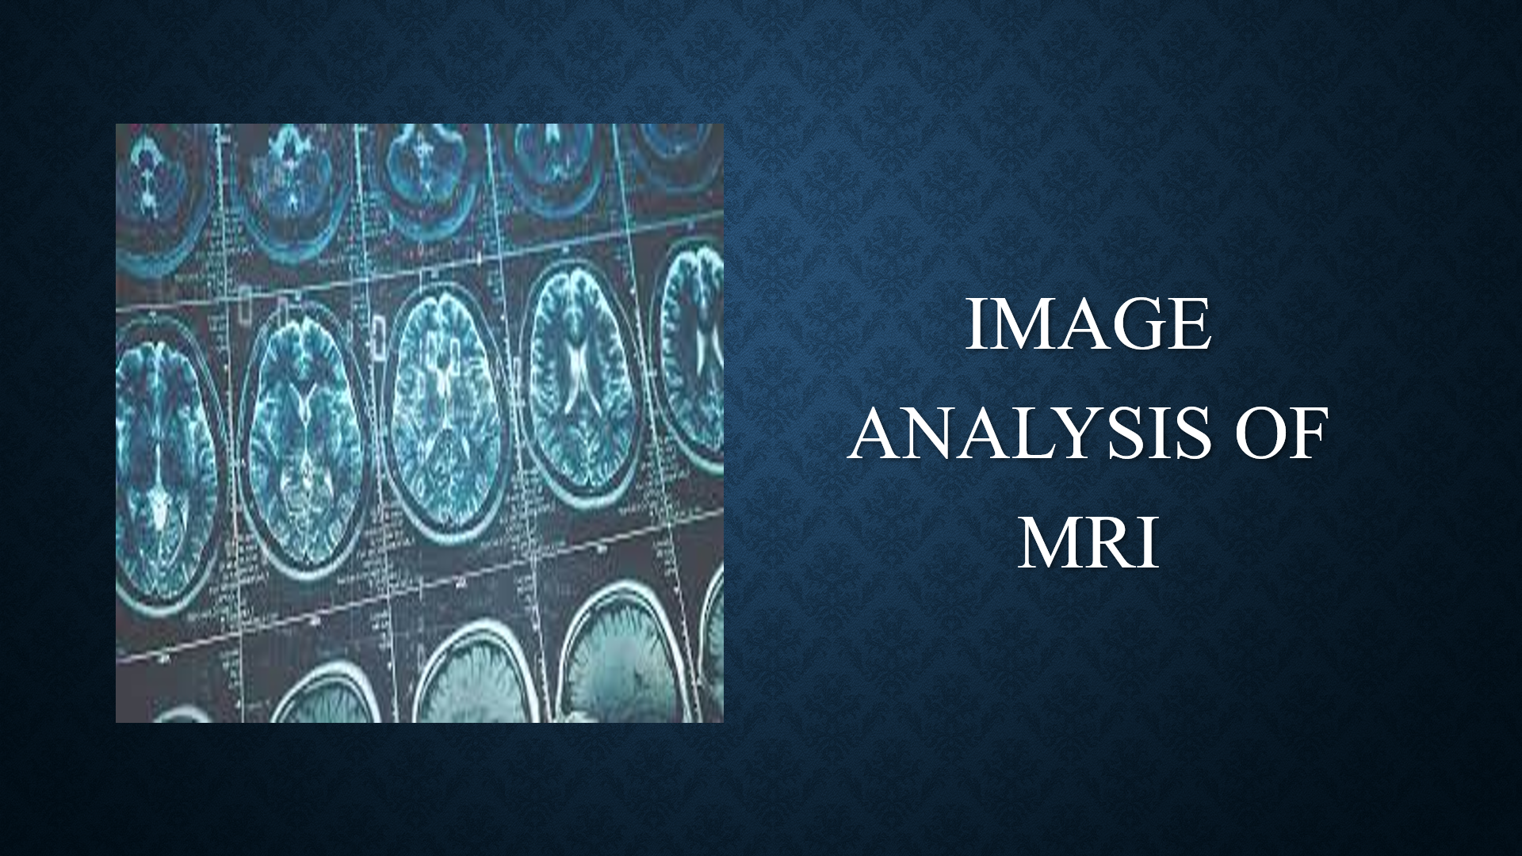
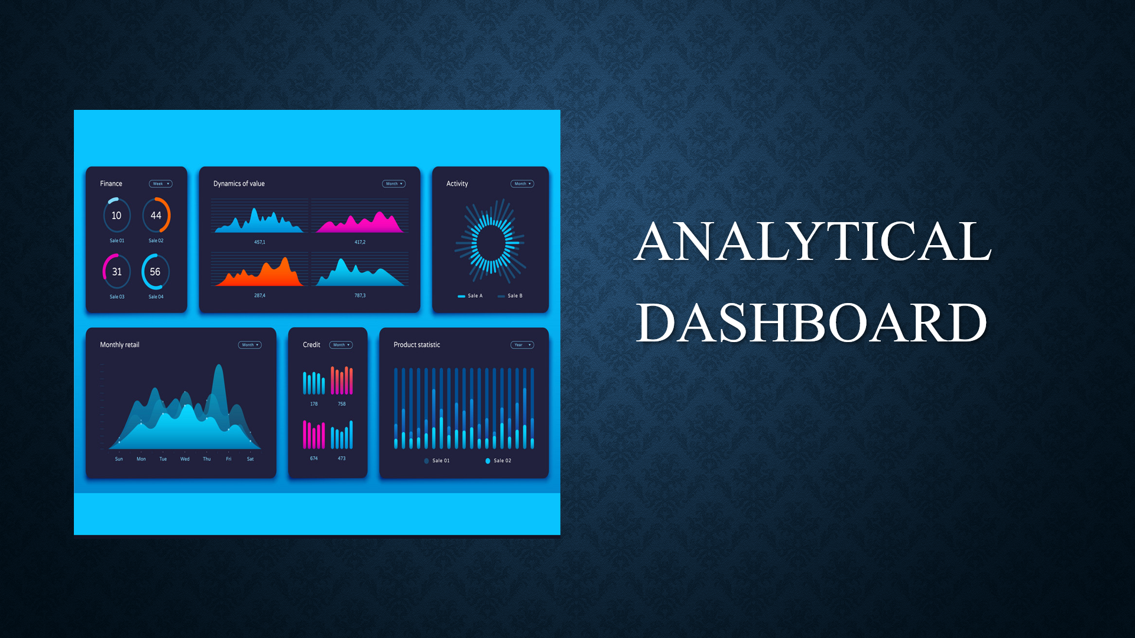
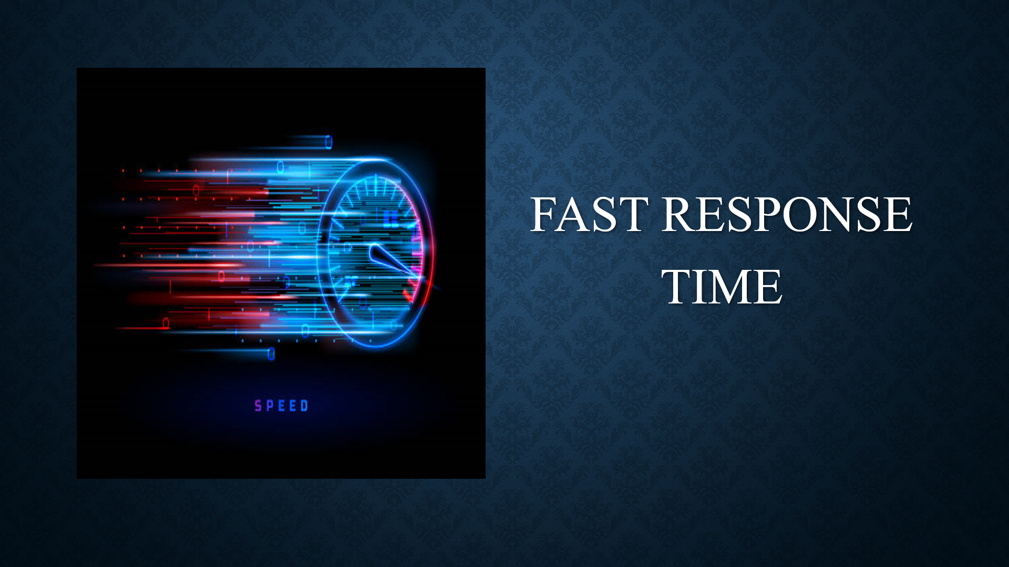
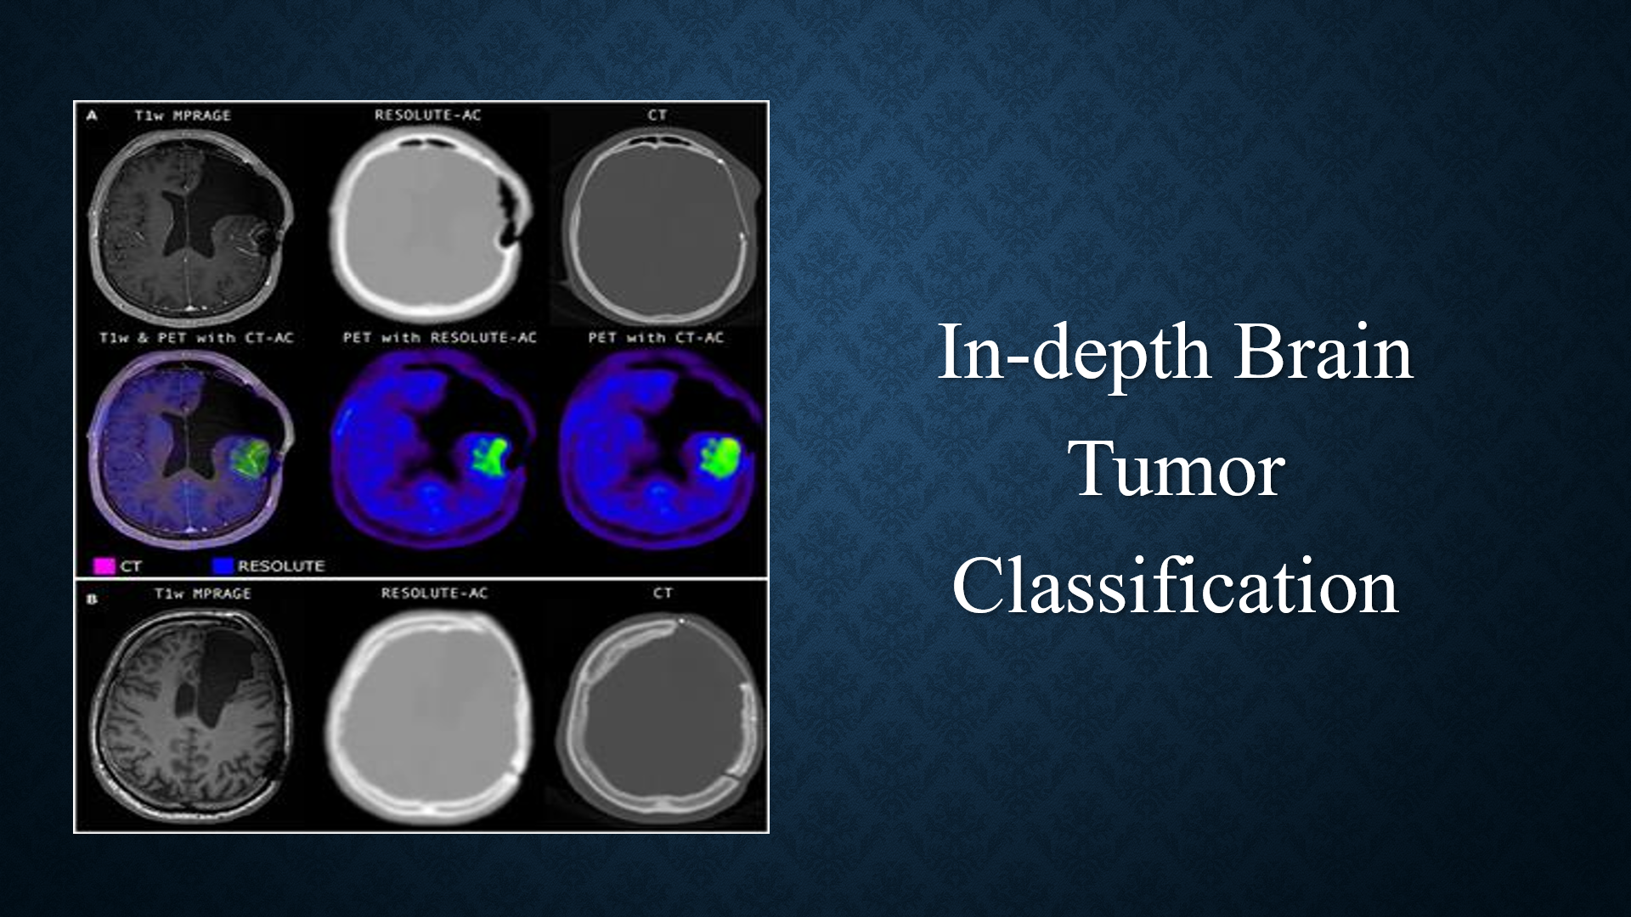

List of features offered by the solution

Slide 5
List of oneAPI Ai Analytics Toolkits, its libraries and
the SYCL/DPC++ Libraries used
Intel VTune Profiler 2023.1
Intel Advisor 2023.1
SYCL/C++ Library
Intel Distribution for Python

Slide 6
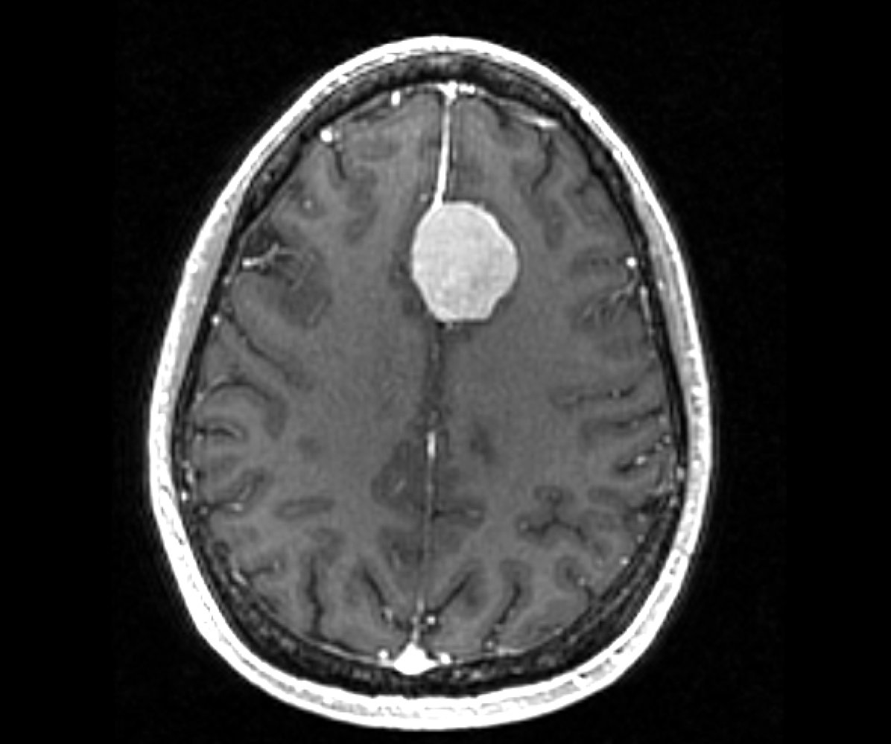
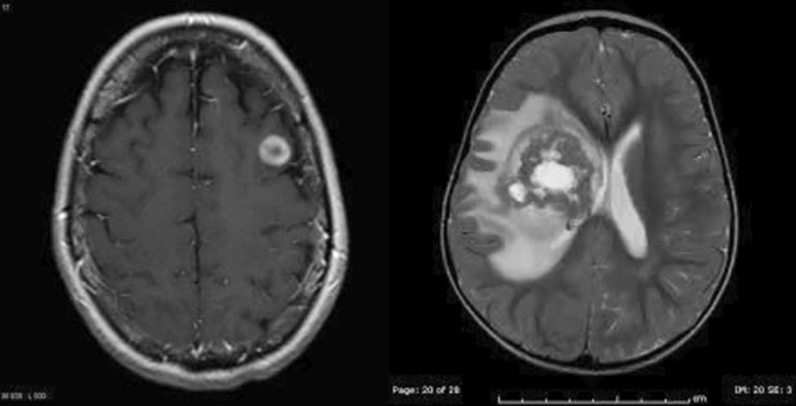
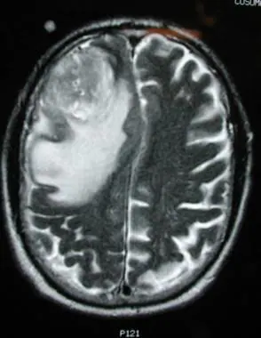
Process Flow Diagram
BRAIN MRI IMAGE DATASET
LOADING IMAGE LABELS
DATA DIVISION & AUGMETATION
+
EXTRACTION OF IMAGES
PRE-PROCESSING
TRAINING (70%)
TEST & VALIDATION (15%, 15%)
DEEP TRAINING NETWORK
NETWORK OUTPUT
TUMOR CLASSIFICATION
BENIGN
BENIGN TO MALIGNANT
MALIGNANT

Slide 7
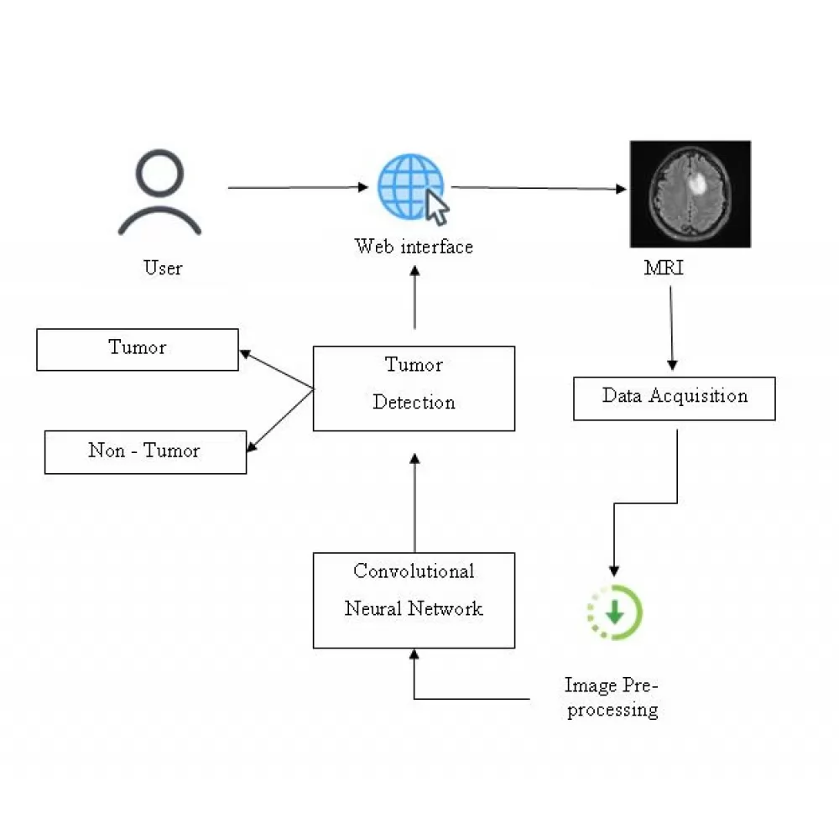
Architectural Diagram

Slide 8
Technologies used
Jupyter Notebook
Visual Studio Code
Anaconda Navigator
Python 3.7.0
Django
Intel One API
Public Brain Tumour Dataset
Intel DevCloud

Slide 9
Estimated cost of/after implementing the solution
Since our product is software based implementing of the same is not a cumbersome process. Since incorporating this project to all Medical Institutes and Hospitals of the country does shows up a cost. Implementation on a larger scale can generate an amount of approximately
~ 20 Lakhs INR for our project idea.

Slide 10
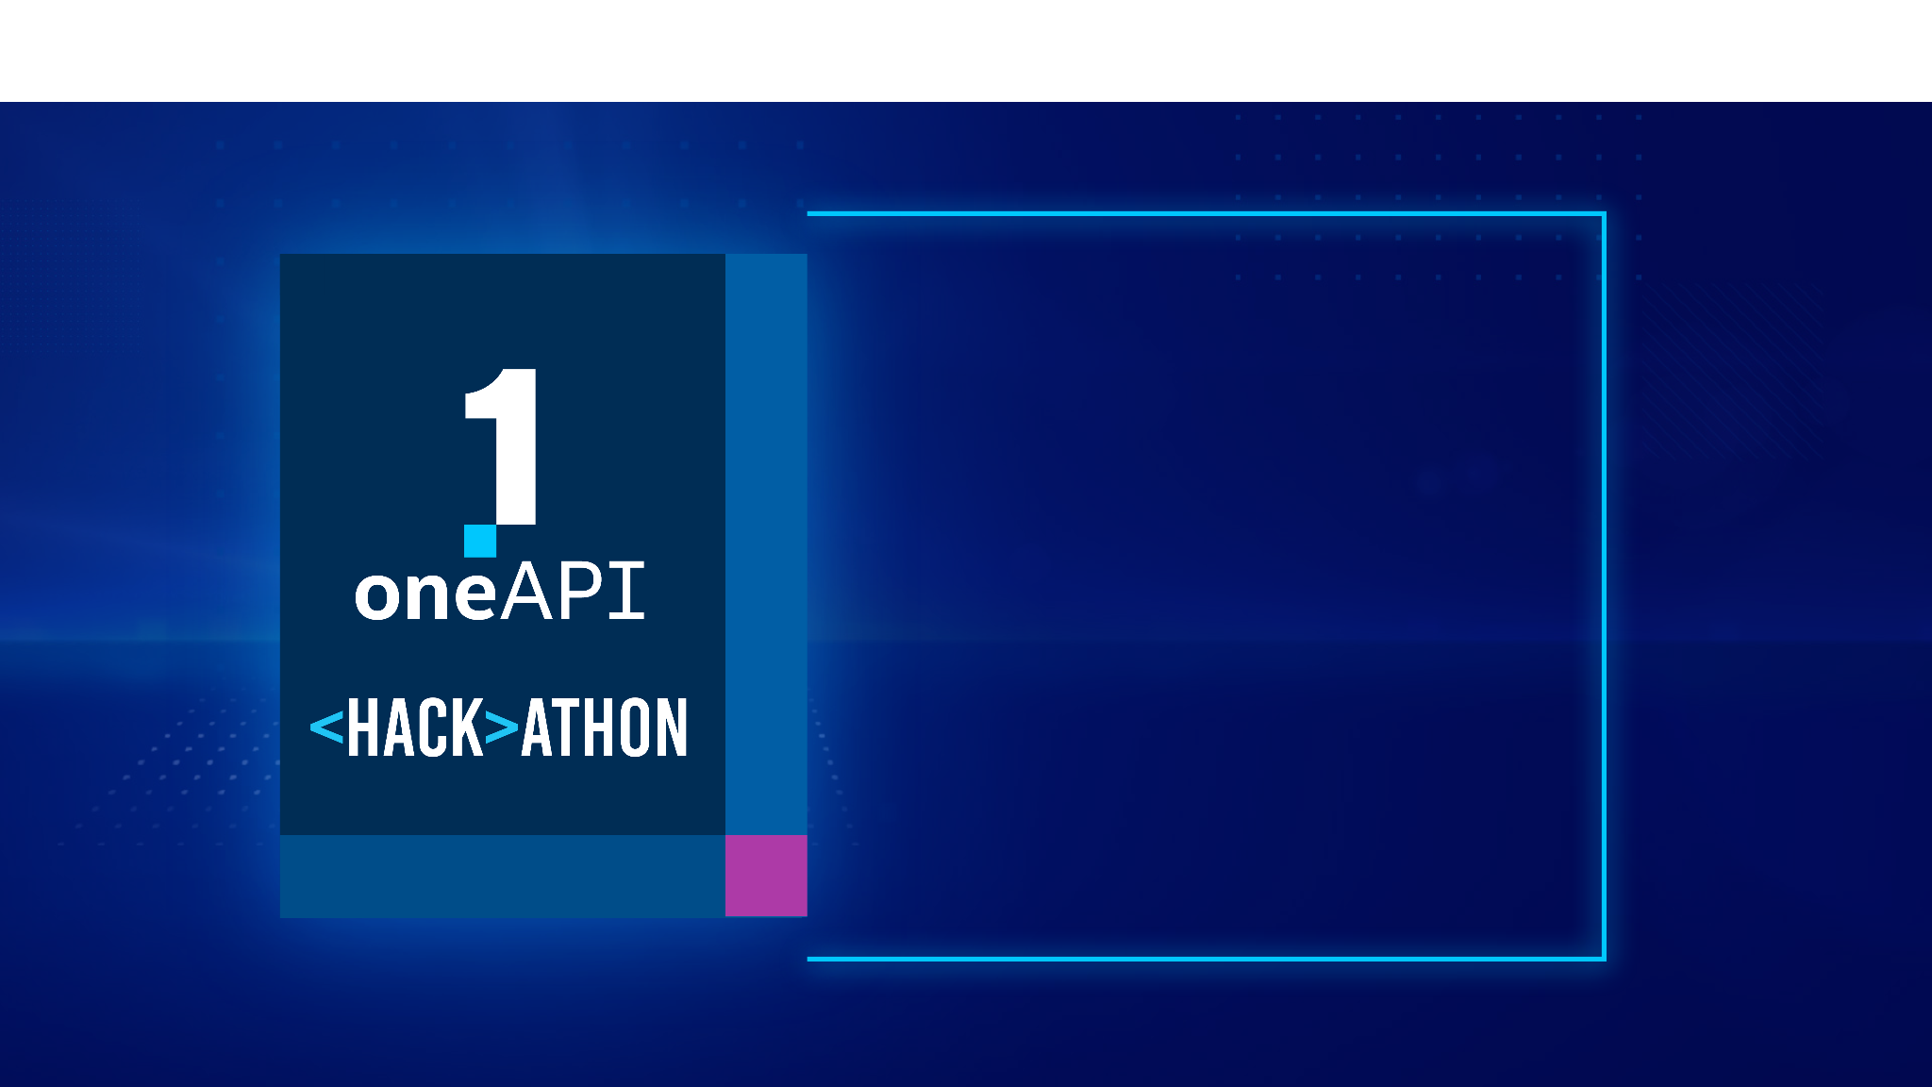
THANK YOU

